Slide 1
Project Final Update
Yazmin, Dustin, Samuel, Candelario

Slide 2
Overview
Introduction
Technologies Used
Design of the system (Summarized)
How to deploy application
Known Bugs

Slide 3
Introduction
Hobby-Pro is a Mobile friendly Simplified Project Managment tool for Hobbyists Created to simplify the process of Project Management for Hobbyists.
The Problem we are hoping to solve with the launch of Hobby-Pro is to cut down on Project Management time and to help simplify the process of managing projects through simplified tools and techniques.

Slide 4
Technologies Used
HTML: was standard since we were making a webpage
CSS: was also standard but the difficulty gap for other members made managing CSS code a hassle so Bootstrap was selected to help control the scalability of CSS framework
Vue.Js: JavaScript framework that combines out HTML and CSS into workable components made creating a seamless website simple
Bootstrap: Used to develop our website as responsive and mobile-friendly

Slide 5
Technologies Used
Firebase Authenticate: Used for the onboarding of the application. Firebase handled the security aspect.
Firebase Firestore: Firestore was chosen for its shallow querying capabilities allowing for a nested data structure in the database
Firebase Cloud storage: we choose to use firebase's cloud storage to store large files and images in the cloud.
Javascript: Used for client-side scripting for interactivity and dynamic content generation.
Visual Studio Code IDE: we used VS Code as our main IDE for this project since all members were familiar with functionality.

Slide 6
Design of the System
Components:
Onboarding:
LoginView.vue
RegisterView.vue
ForgotPaswordView.vue
PasswordResetSucess.vue
Script Files
Firebase_config.js
Routing:
Index.js
Store:
Index.js
Dashboard:
DashboardView.Vue
MainDashboard.Vue
Profile.vue
CompletedProjects.vue
CreateProject.vue
Library.vue
ProjectDashboardView.Vue
Overview.Vue
EditOverview.vue
StageDetails.vue
NavigationBar.vue
ProjectNavigationBar.vue

Slide 7
Design of the System
Main Dashboard:
This houses the Project cards that show off your project to the screen so the user can see all ongoing projects.
The cards are shown through a v-for which is a for-each loop method in which it cycles through your projects and displays them to the screen
There are methods that fetch projects methods that calculate the days Left and methods for sorting the projects on the screen.
Navigation Bar:
We have two of these one for dashboard navigation, and one for project navigation.
This component oversees displaying all nav links to the screen for the user to see so they can get to each page.
The project variant has nav elements that are loaded in which is dependent on the number of stages the user has on their selected project.

Slide 8
Design of the System
Profile:
This component displays the current user's info including their first and last name and their email.
We also have methods for calculating project numbers including but not limited to:
Total ongoing projects
Total completed projects
Total projects
Finally, the user can change their profile picture and if done will display their profile image on not only that page but in the navigation on the top right of the navigation Bar component.

Slide 9
Design of the system
Routing: this part of the system is thanks to Vue's built in routing system it allowed us to specify components in our system which allowed for quick swapping of components present of the page.
With the routing it made page traversal a whole lot easier to manage. And it cut down our navigation to one components just for Navigation only
This .js file contains all the imported components that you might route to and links them by routes. You can even assign some routs child routes which acts as its own separate page if you want.

Slide 10
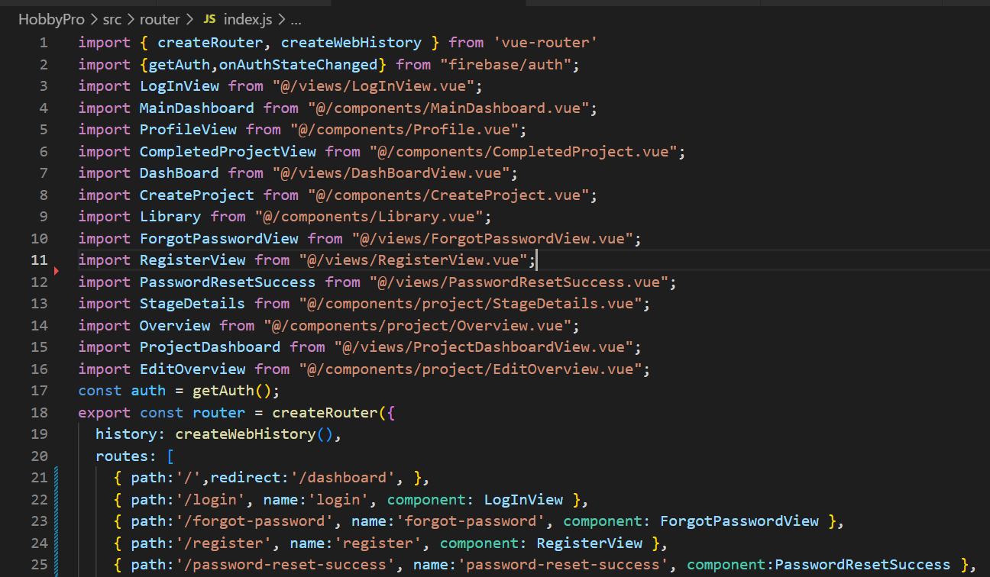

Slide 11
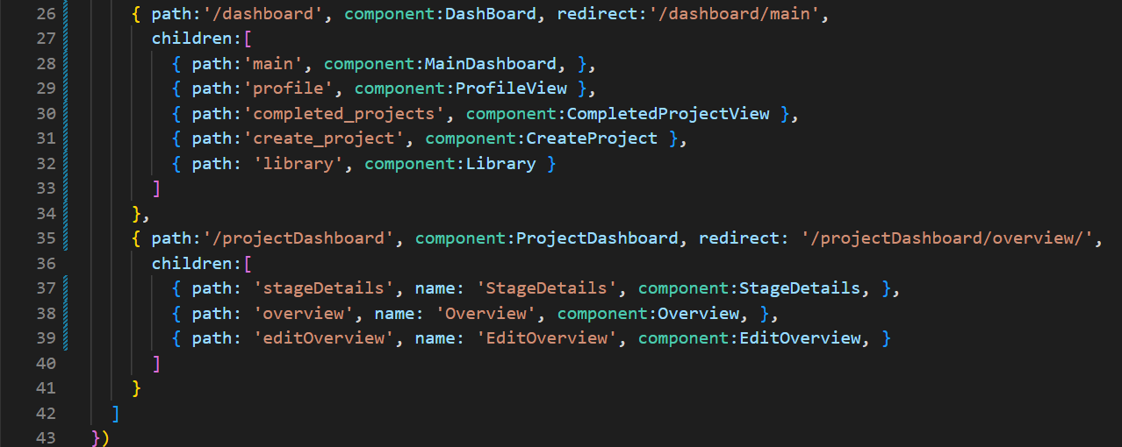

Slide 12
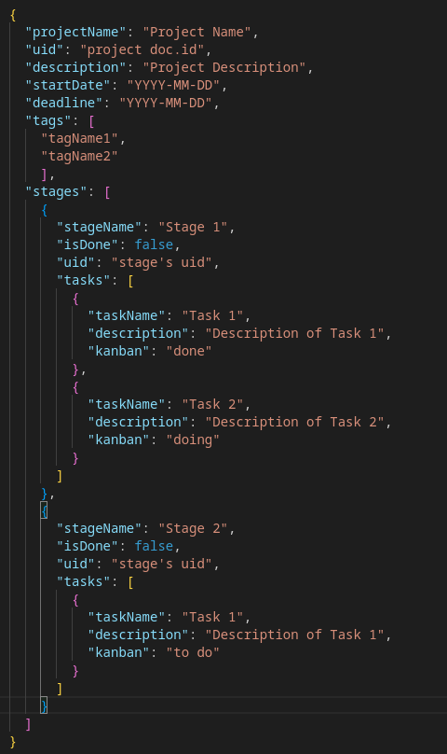
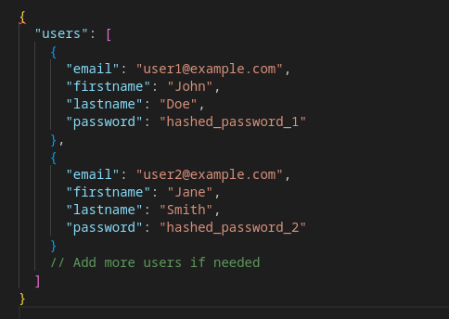
DATABASE SCHEMAS

Slide 13
Set Up Project for Deployment
**** run command before initializing deployment: npm run build
Install the firebase CLI by running : npm i firebase-tools –D
Check to make sure your logged into the correct firebase account: node_modules/.bin/firebase login:list
If not logged in, log in using : node_modules/.bin/firebase login
If you have multiple projects select the project you want using: node_modules/.bin/firebase use <project id>

Slide 14
Set Up Project for Deployment (cont.)
Initialize deployment: node_modules/.bin/firebase deploy --only hosting
When asked use public folder, type: /dist
When asked configure as single page app type: yes
When asked set up with git hub automatic builds: no
When asked overwrite index.html, type: no

Slide 15
Deploy
npm run build
node_modules/.bin/firebase deploy --only hosting

Slide 16
Known Bugs to Squash
There is a bug on IOS Devises where the navigation on both main dashboard view and Project Dashboard view is not present could be related to visibility not properly be changed when the screen size is below the designated amount.
Possible fix: could be a simple fix with multiple tests of changing values and watching them to ensure that the navigation becomes visible will need a mac to ensure that this is possible.
There is a bug that on refresh of the project pages currently it wipes the data out to where the data is no longer available for use on those pages
Possible fix: implementing persistent Data like a local storage that works while on the website would ensure that the data or the current project being edited or manipulated would ensure that the data stays despite page reloads.

Slide 17
Known Bugs to Squash
There is a Bug happening with stages where when the user navigates to a projects page the user might see either an initial stage button(intended), a set of three stage buttons(previous but unintended), or nothing(unintended).
This one is tricky and will have to be investigated thoroughly. It is possible it has something to do with how we are routing around the different Vue components, as well as how we are handling state.

Slide 18
Live Demonstration
https://hobbypro-7fa90.web.app

